Slide 1

FINAL PRESENTATION
Name: Aastha Niraula
Bsc.(Hons) Computing
University ID: c7227225

Slide 2

Introduction
An Online Food Delivery Application

Slide 3
Project Scope
Interfaces for customer and admin.
Easy access to login and register
Customers can navigate through the restaurants and the digital menu
The food items added to cart
Checkout

Slide 4
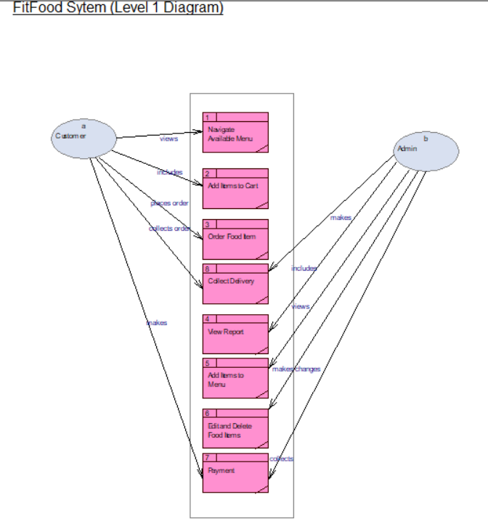
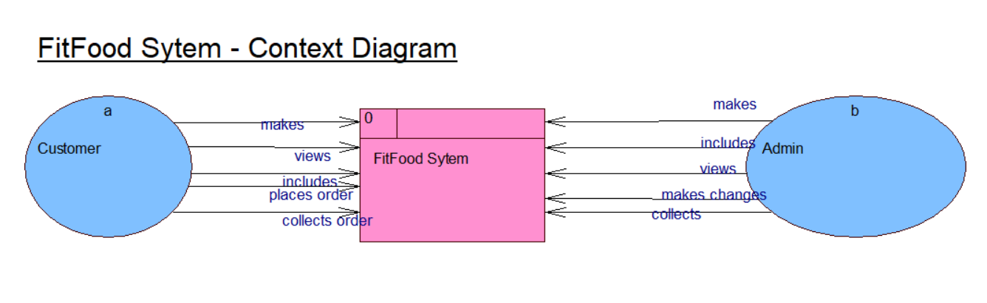
Executing Phase
Diagrams (DFD)

Slide 5
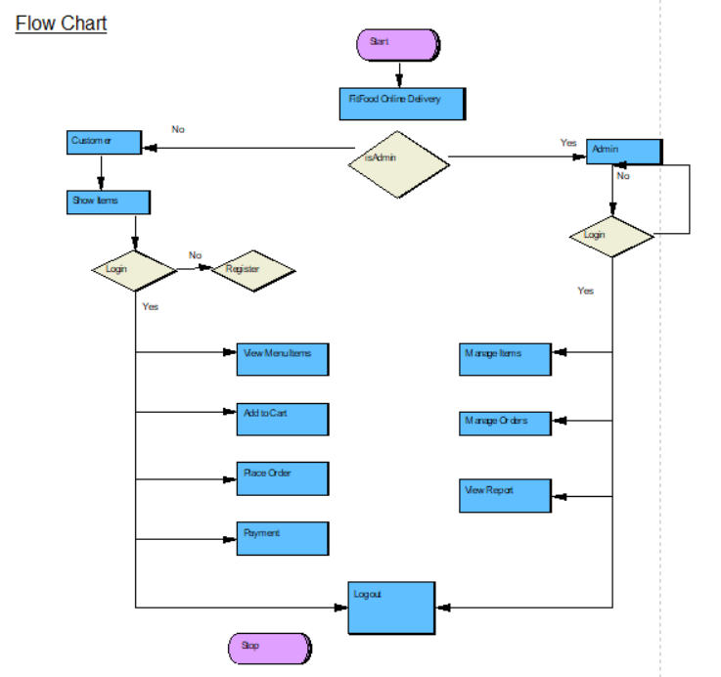
Executing Phase
Diagrams (Flowchart)

Slide 6
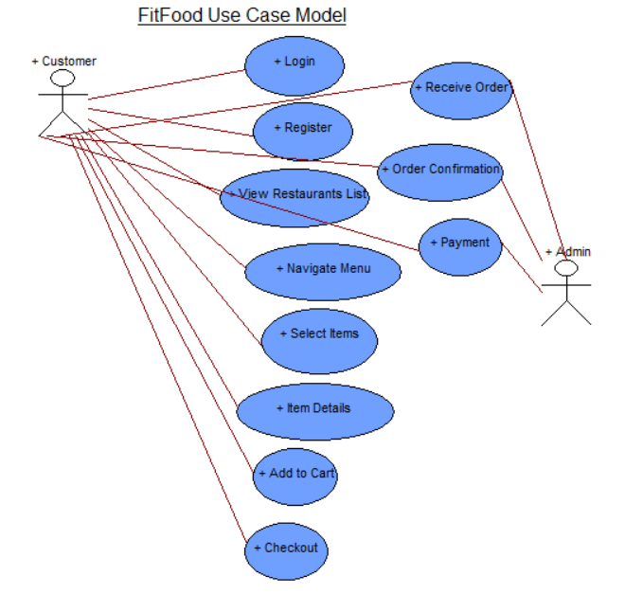
Executing Phase
Diagrams (Usecase)

Slide 7
Executing Phase
Functional Requirements
Description | MoSCoW
Signing up as customers will create a separate profile for the customer | S
Include search option based on category, dishes and delivery time | M
Searching of products based on location, e.g. restaurants nearby | M
Personal profile includes coupons, discounts and other marketing strategies. | C
Menu including pictures of food items along with prices | C
Delivery time estimating distance, food preparation time, size of order, etc. | W
Watch the whole delivery process in real time | W
Payment integration option | M
Status about order confirmation, pickup or delivery | C
Fastest routes choosing with information regarding traffic jams. | C
Ratings and reviews given by customers | W
Set delivery location for the customers | M

Slide 8
Executing Phase
Functional Requirements
Description | MoSCoW
Display the list of categories of food items | C
Separate view for a food item with detailed information | S
Cart to display all the food items that is added | S
Choose the quantity of food items and display it | M
Display the total amount to be paid after adding to cart | M
Login and register forms for the users | M
Verification of users either by OTP or email | C
Different orderID after each order being placed | C
Feature of cancelling the order | W
Offers and deals that can be used while ordering | W

Slide 9
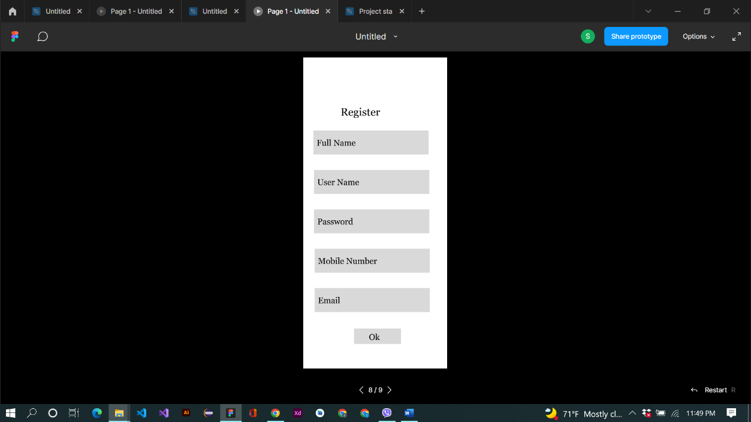
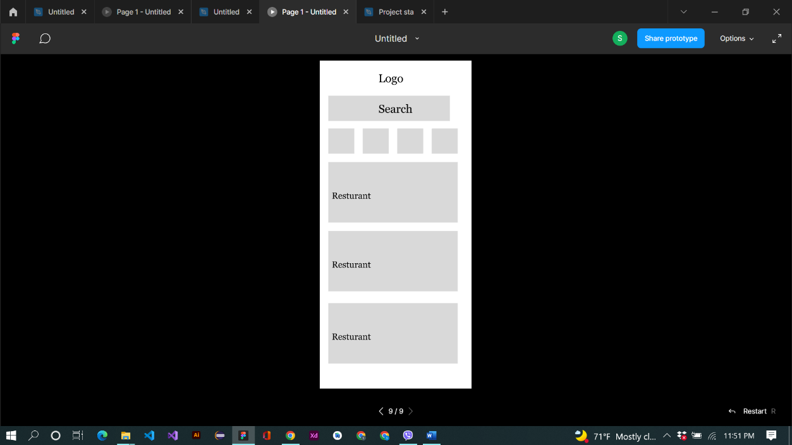
Executing Phase
Wireframes

Slide 10
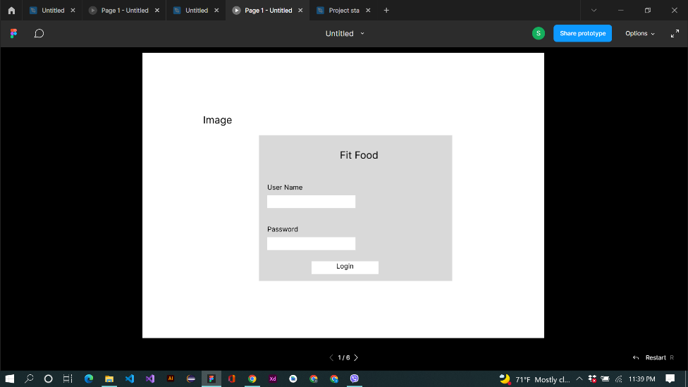
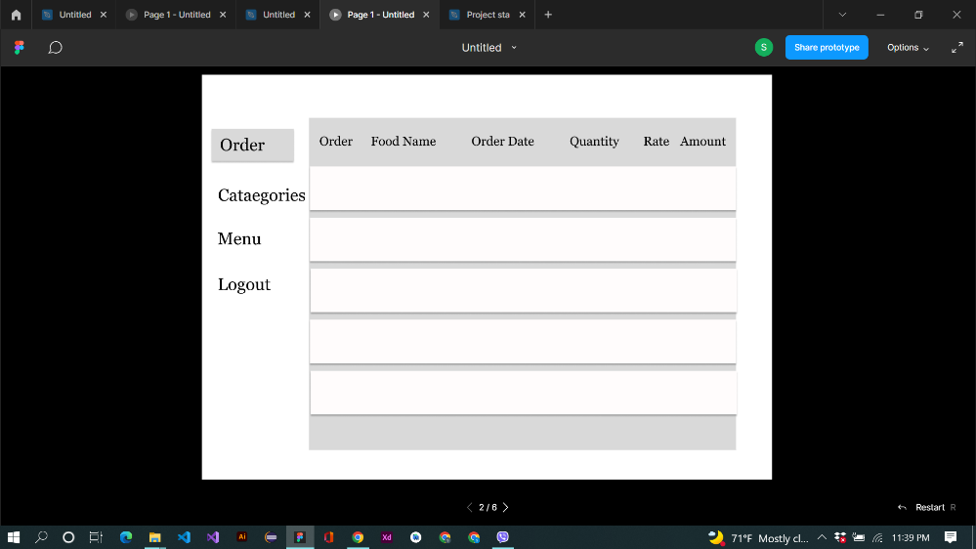
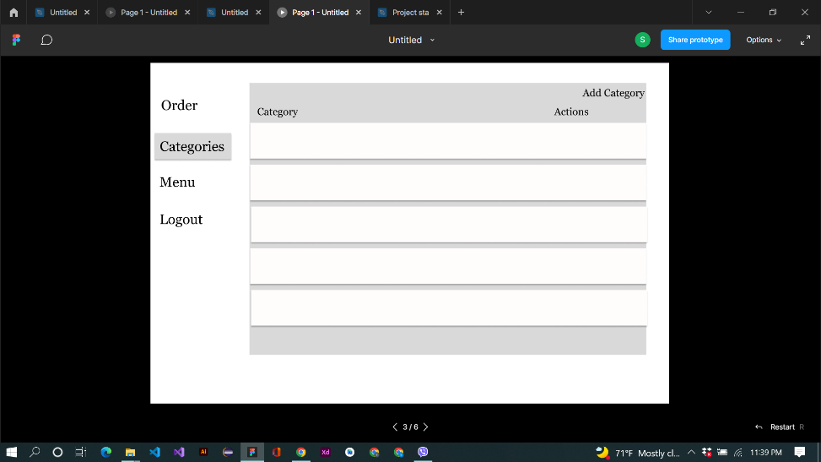
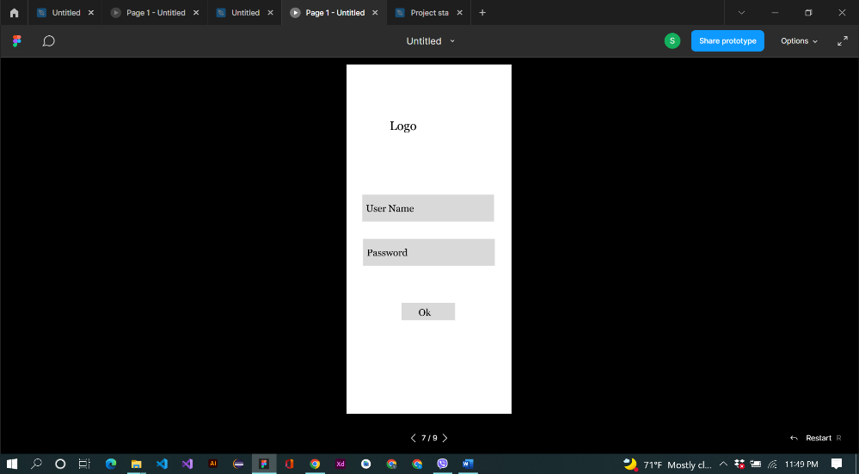
Executing Phase
Wireframes

Slide 11
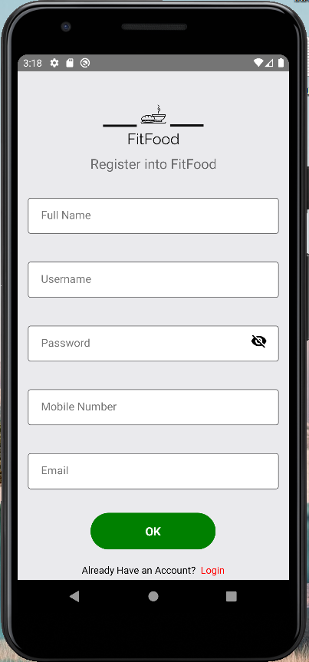
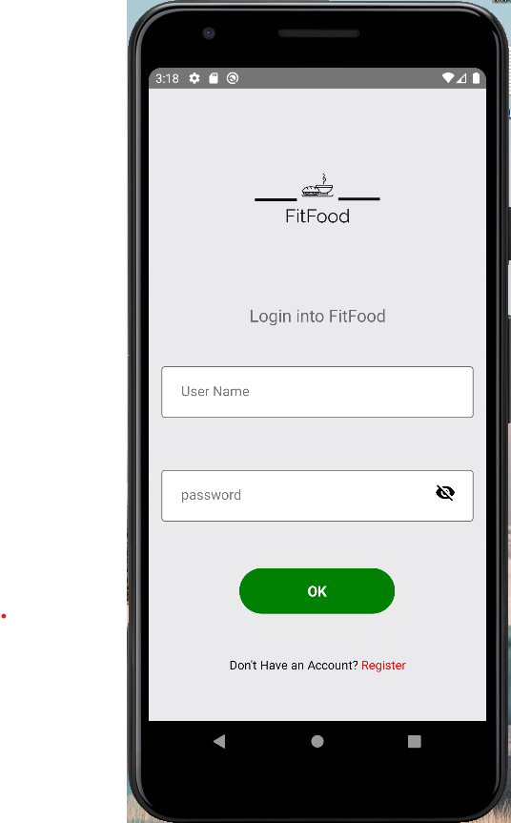
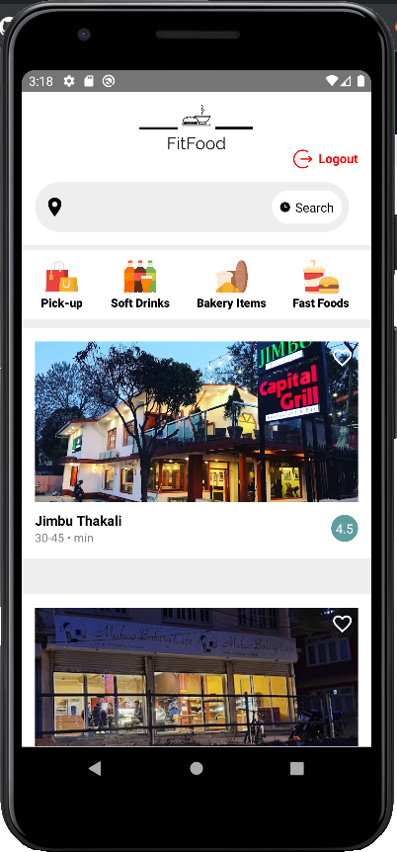
Implementing Phase
User Interface

Slide 12
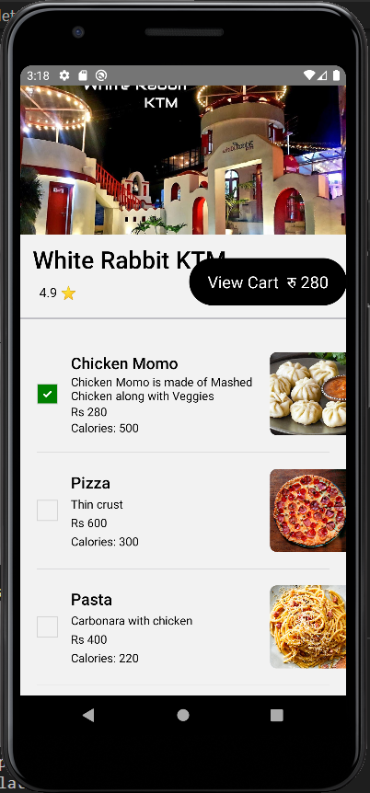
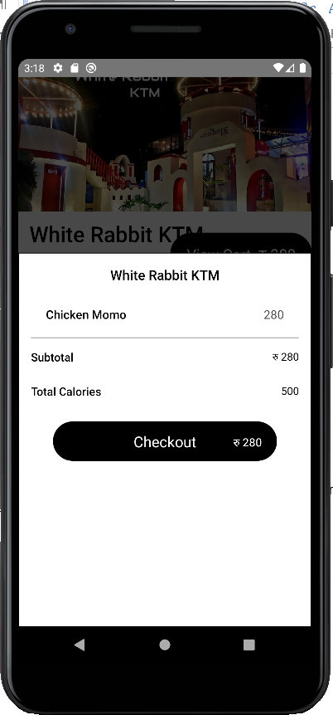
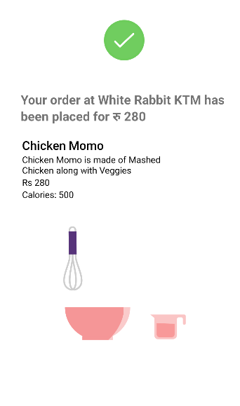
Implementing Phase
User Interface

Slide 13
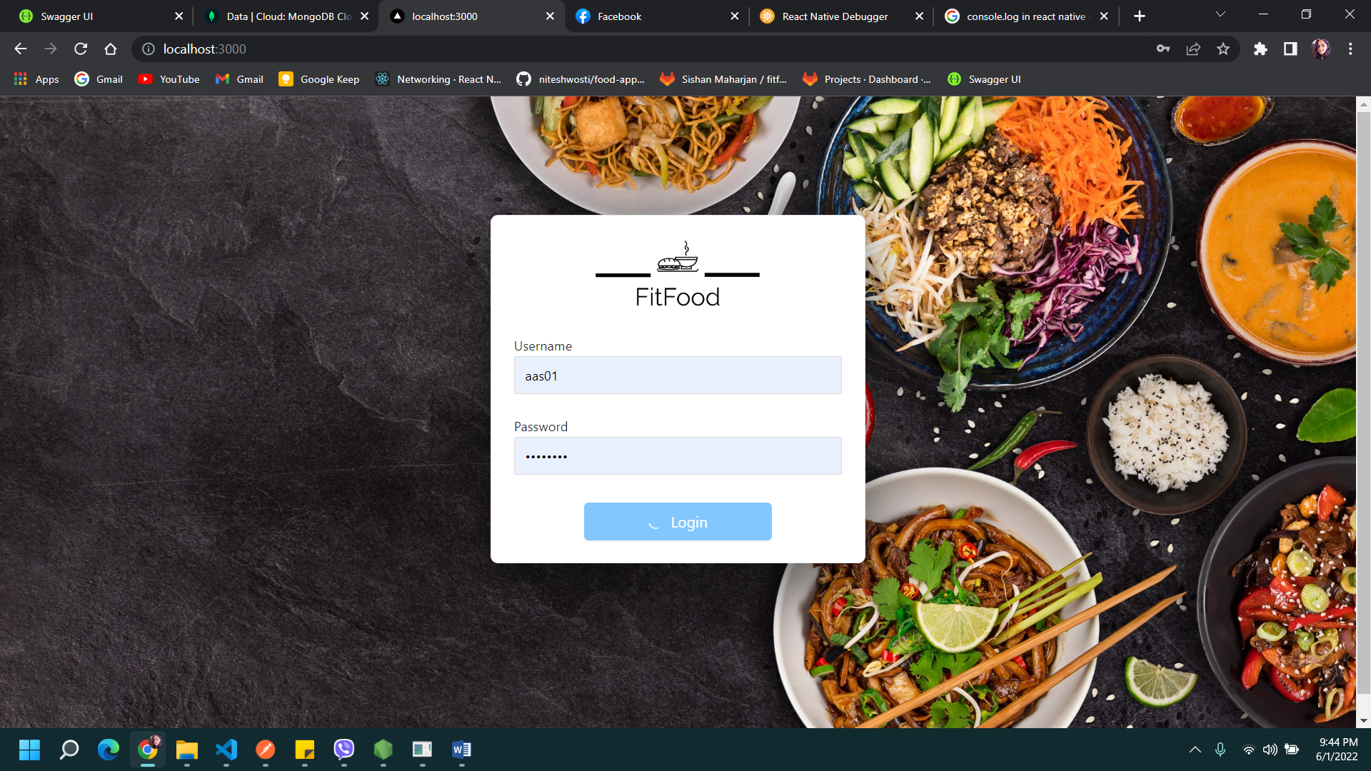
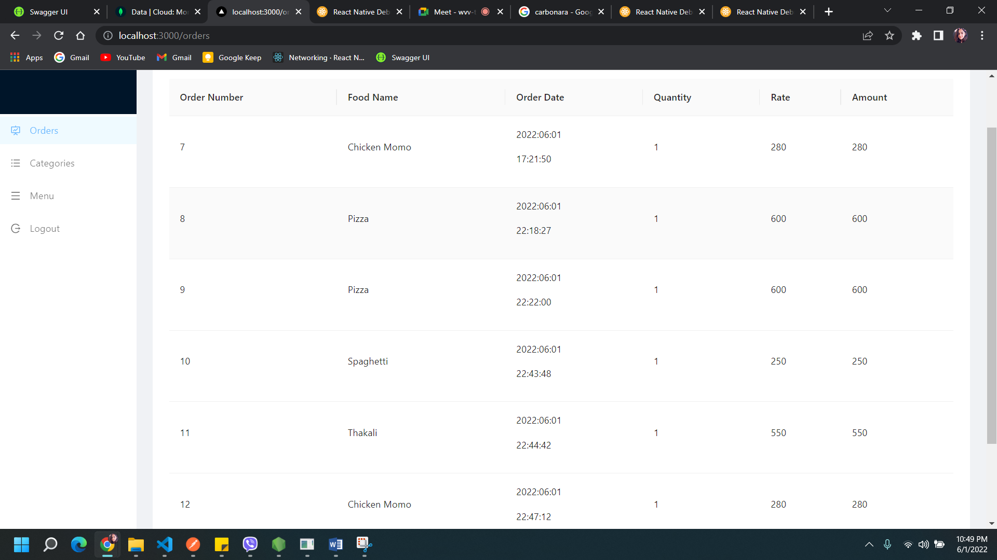
Implementing Phase
Admin Dashboard

Slide 14
Thank You!

